Slide 1
Linear discriminant analysis
Bhuvaneshwari Patil

Slide 2
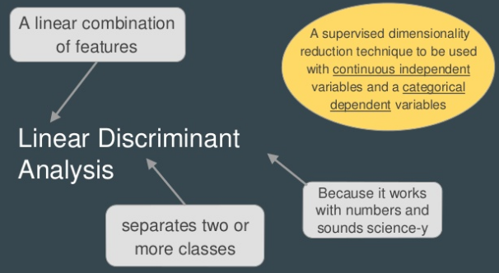
What is LDA?

Slide 3
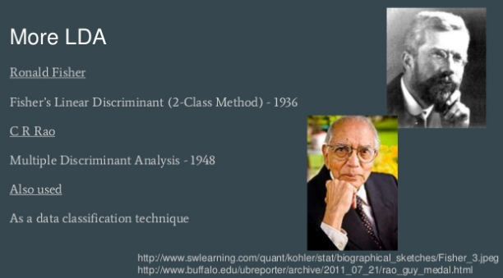

Slide 4
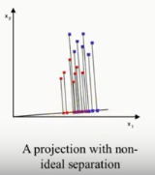
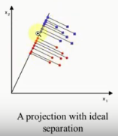
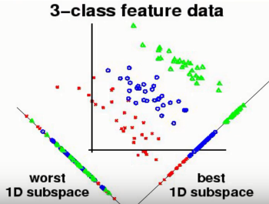
LDA Examples

Slide 5
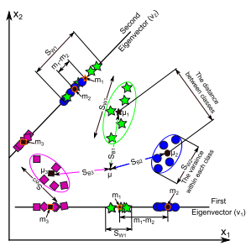
Projection line / plane
A visualized comparison between the two lower-dimensional sub-spaces which are calculated using three different classes.

Slide 6
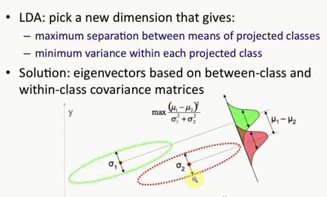
Fisher’s Ratio

Slide 7



LDA Algorithm
Given a set of N samples [x_{i}] _{i} ^{N} =1, each of which is represented as a row of length M
Compute the mean of each class μi(1 × M)
Compute the total mean of all data μ(1 × M)
Calculate between-class matrix SB(M×M) as follows
Compute within-class matrix SW (M × M), as follows
where xij represents the ith sample in the j th class

Slide 8
LDA Algorithm
The matrix W maximizes Fisher’s Ration, given by
W = S⁻¹ _{W} S_{B}
Calculate the eigenvalues (λ) and eigenvectors (V ) of W
Sorting eigenvectors in descending order according to their corresponding eigenvalues.
The first k eigenvectors are then used as a lower dimensional space
Project the original sample X on to the lower dimensional space of LDA

Slide 9
Major Drawbacks
Linearity Problem
Using kernel functions
Small sample size problem
Regularization (RLDA)
Sub-space
Null Space

Slide 10
Applications of the LDA technique
Biometrics applications
feature extraction (including pre-processing steps) and recognition
Agriculture application
an unknown sample can be classified into a pre-defined species
Medical applications
the data such as the DNA microarray data consists of a large number of features or dimensions, increases computation time.

